Slide 1
Ion University: Technology Ion Chef & OT2 w/ S5™ & S5xl™
July 2016
Robert David, Staff Field Applications Specialist

Slide 2
S5 XL System Operations Training Agenda
Ion University
Overview of Ion Torrent Sequencing technology and Primary data analysis
Hands-on training
Library Preparation on the Ion Chef
Template Preparation & Chip Loading on the Ion Chef™
Clonal Amplification
Recovery
Enrichment, QC option
Chip loading
Sequencing on the S5™ XL
Discussion
Library Preparation
Data Analysis

Slide 3
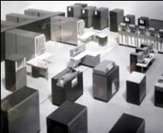
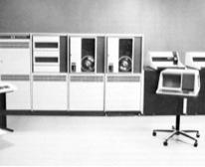

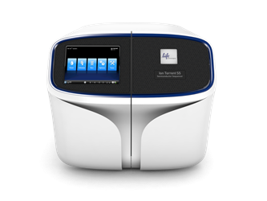
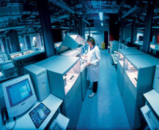
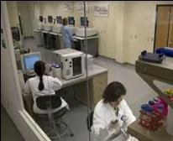
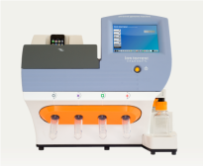
Our Enduring Belief that Ion is Disruptive
Main Frame
Mini Computer
Personal Computer
Sanger Sequencing
Next-Gen Sequencing
Ion Semiconductor Sequencing
Generations are defined by who can use them.

Slide 4
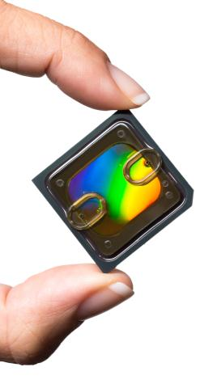



Founding Principles of Ion Torrent
CMOS technology
40 years of Moore’s law
Natural nucleotides
No lasers
No optics
No camera
No fluorescence
No enzyme cascade
Rapid detection of sequence extension

Slide 5
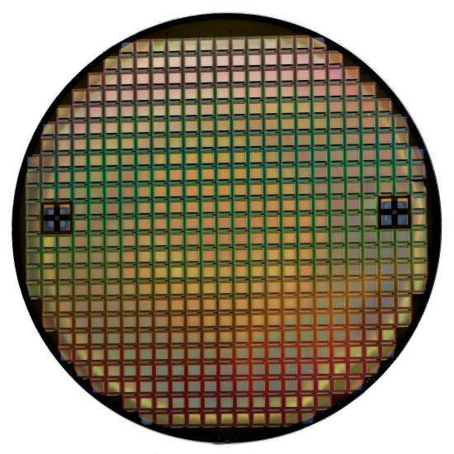
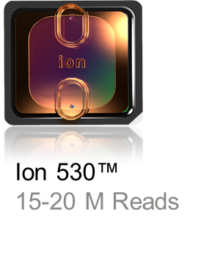
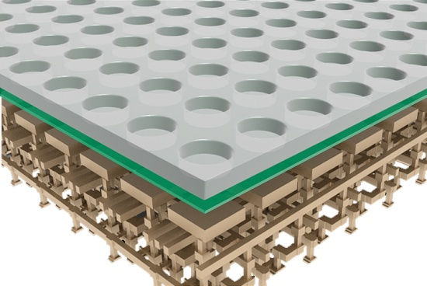
Semiconductor Technology
Wafer
Chip
Chip Cross Section
Notes:
Wafer – the semiconductor material. Serves as the substrate for microelectronic devices.
Chip – has a flowcell on top of it to deposit the sample.
Cross – section – sensor layer of the chip where a change in pH ultimately measures a change in voltage and then turned into Base Calls (fastq files)
Complementary metal–oxide–semiconductor (CMOS) is a technology for constructing integrated circuits.
No Lasers, Fluoresnce, optics, cameras etc.
Rapid detection of sequence extension

Slide 6
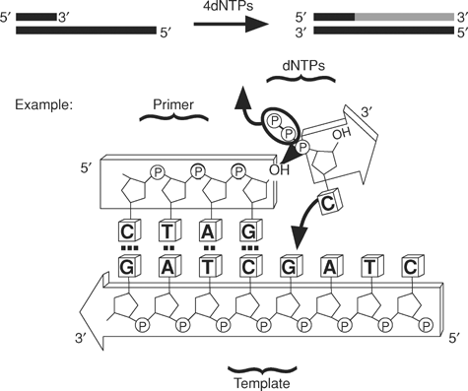
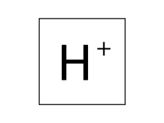
Natural Chemistry
Natural nucleotides
No lasers
No optics
No camera
No fluorescence
No enzyme cascade
Notes:
Main idea here is the chemistry is “natural” in the sense that we don’t modify the dNTPs. When we flow 1 dNTP at a time, if there is an incorporation, a hydrogen ion is released on each template on the Ion Sphere Particle (only one shown here). This release of H+ causes a change in the pH of the well that is detected by our “ion sensitive layer” at the bottom of each well. So the signal we detect is caused by an incorporation event, and we know what dNTP we were flowing at that time, so we infer what base was on the template. If no signal is detected (other than background) we assume no incorporation during that dNTP flow.

Slide 7
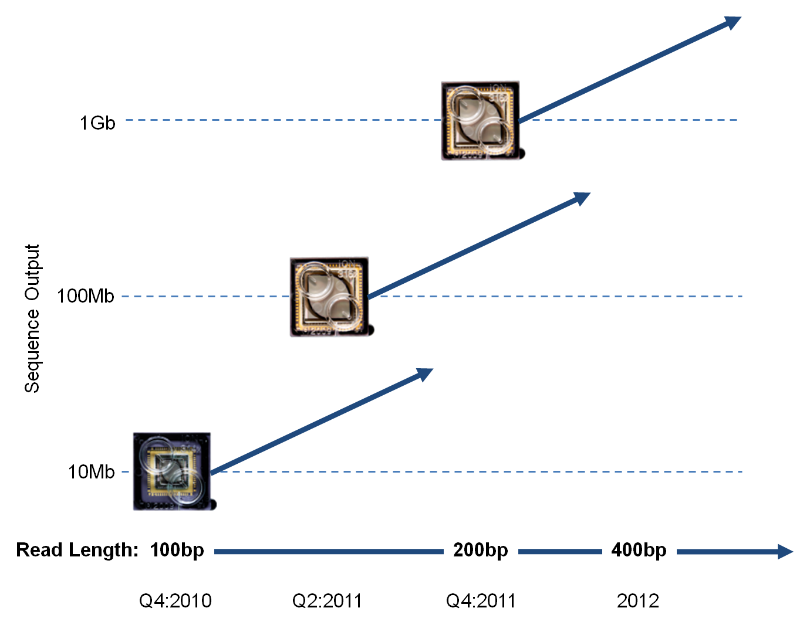
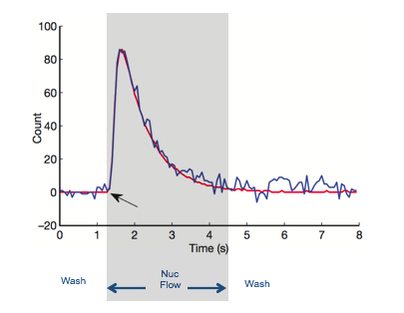
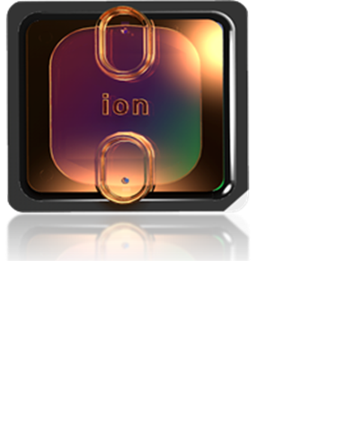



Fast Direct Detection
dNTP
H⁺
∆ pH
ISP
∆ Q
Sensing Layer
Sensor Plate
∆ V
Bulk
Drain
Source
To column
receiver
Silicon Substrate
Rothberg J.M. et al Nature doi:10.1038/nature10242
DNA → Ions → Sequence
Nucleotides flow sequentially over Ion semiconductor chip
One sensor per well per sequencing reaction
Direct detection of natural DNA extension
Millions of sequencing reactions per chip
Fast cycle time, real time detection
Notes:
Speed
Rapid detection of sequence extension
Schematic representation of one microwell on the surface of a chip
High signal to noise
Enables high raw accuracy
One sensor per well per sequencing reaction
Orange circle is an Ion Sphere Particle onto which is clonally amplified the sequence fragment resulting from library preparation or amplicon PCR
Release of H+ ions as nucs incorporate generates a pH change inside the well which in turn causes charge accumulation in the Ion sensitive layer which then in turn causes a voltage increase mediated through the transistors directly underneath each well. Voltage signals are turned into base calls and output either as Ionograms (SFF files) or bases (FastQ) files
Sample at variable frame rate across pre-wash, nuc-flow, and post-wash

Slide 8
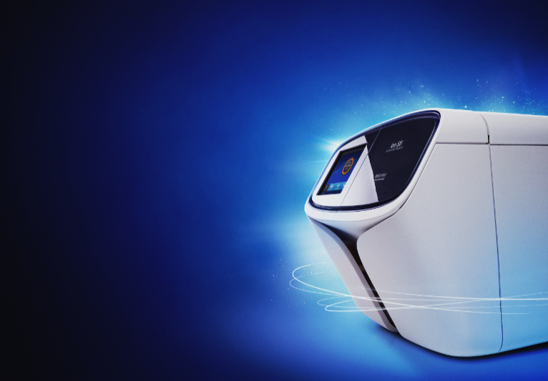
Applications
Ion S5 and Ion S5 XL Systems
Simplest and fastest targeted sequencing system
with the lowest capital investment
Simplest NGS targeted workflow - <45mins total hands-on time from DNA to data with Ion Chef™ System
Fastest run time – as little as 3.5 hours from sequence to BAM files.
Lowest capital investment - Single platform for all targeted applications with flexibility to scale
Lowest DNA/RNA input requirements – 1-10ng using Ion AmpliSeq™ technology
Easy setup and training – single day installation and plug and play cartridge-based reagents

Slide 9


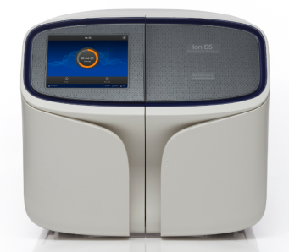
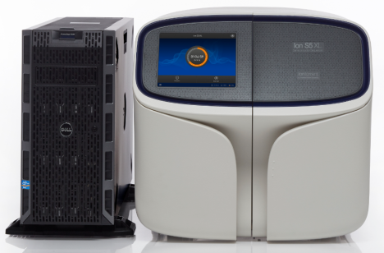
Ion S5™ and S5™ XL Systems.

Slide 10


Ion S5 and Ion S5 XL Systems Sequence up to 15 Gb in < 8 hours
Rapid time to answer
Affordable flexibility
 | 200bp Sequencing Time Ion S5/S5 XL | 200bp Analysis Time* Ion S5 XL | 200bp Analysis Time* Ion S5 | Output | Reads | Read Length
Ion 520 Chip | 2.5 hr | ~1 hr | ~5 hr | 1-2 Gb | 3-5 M | Up to 400bp
Ion 530 Chip | 2.5 hr | ~2.5 hr | ~8 hr | 3-5 Gb | 15-20 M | Up to 400bp
Ion 540 Chip | 2.5 hr | ~5 hr | ~16.5 hr | 10-15 Gb | 60-80 M | Up to 200bp
Analysis time to BAM file
Notes:
520 is 318 equivalent
540 is PI equivalent

Slide 11
Ion Torrent Workflow
Library
Preparation
Template Preparation*
Sequencing*
Data Analysis
Notes:
Set expectations of the class:
There are several parts of the Ion workflow. The important phases are broken u here. The parts in blue we will go over in the lab together. This course does not cover the Library Prep portion of the workflow but we do offer several courses which cover this portion of the workflow.

Slide 12

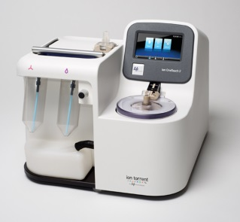

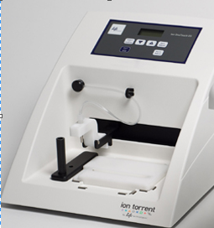
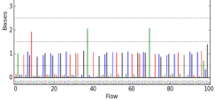
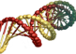

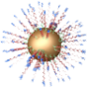

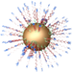

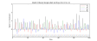
Ion Workflow Overview
A
DNA
B
Compatible Library Prep
C
10
Template Prep
10
Prepare
Library
Clonal
Amplification
Isolate Positive
Ion Sphere™
Particles
Load Chip
and Sequence
D
Data Analysis
Sequencing
E
Compatible Data
Notes:
Ion Torrent Systems, Inc.
12

Slide 13
Ion Workflow – Library Preparation
Library Preparation
Template Preparation*
Sequencing*
Data Analysis
gDNA /
Long Amplicon
Libraries
End Repair
(for physical
shearing)
Fragmentation
(Size dependent)
Adapter Ligation
/ Nick repair
Size selection
Amplification*
(if needed)
Qualify &
Quantify
~2-3 hrs
Short Amplicon
Libraries
~3 hrs
PCR
Clean Up
Quantification
Ion AmpliSeq™
(DNA) Libraries
Multiplex
PCR
Digest Primers,
Phosphorylate
Adapter
Ligation
Amplification*
(if needed)
Qualify &
Quantify
~3.5 hrs
Purify
Ion AmpliSeq™
RNA Libraries
Reverse
Transcript-
ion
Multiplex
PCR
Adapter
Ligation
Qualify &
Quantify
~5 hrs
Digest Primers
Purify
Amplification
Ion RNA
Libraries
Prepare WT
or miRNA
Hybridization /
Adapter Ligation
Reverse
transcription
Qualify &
Quantify
~5-6 hrs
Size selection
Amplification
*extra option: Ion Library Equalizer™ Kit
Notes:
Many application specific Library Prep protocols to chose from.
For examples RNA or DNA, Frag, Ampliseq or RT workflows. Note all are less than 1 day and all share several steps. Varied workfows for all customers
Emphsize Ion AmpliSeq libraries.

Slide 14
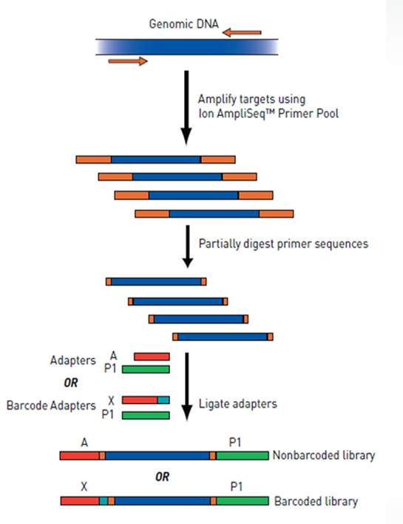
Ion AmpliSeq™ DNA Library Prep
Design your own with AmpliSeqTM Designer
Fast library Prep
Ultrahigh multiplex options

Slide 15
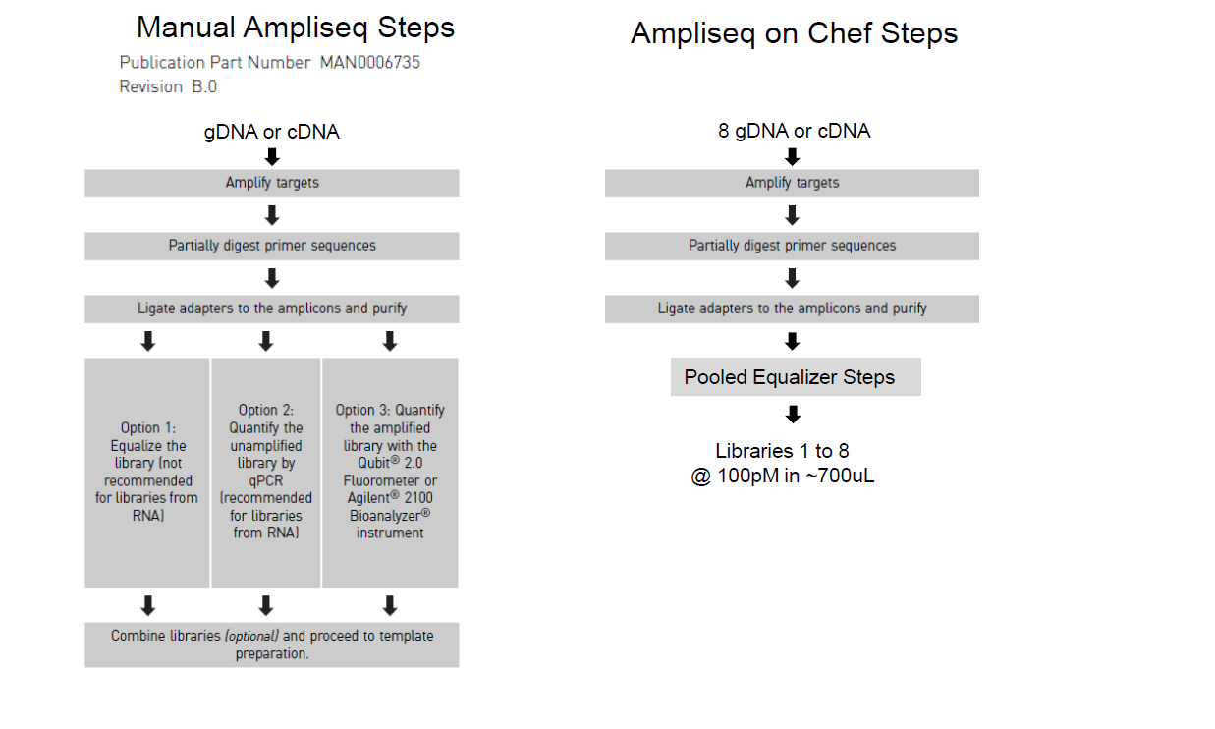
High Level Workflow Comparison

Slide 16
Ion Torrent Workflow
Library
Preparation
Template Preparation*
Sequencing*
Data Analysis
Notes:
Set expectations of the class:
There are several parts of the Ion workflow. The important phases are broken u here. The parts in blue we will go over in the lab together. This course does not cover the Library Prep portion of the workflow but we do offer several courses which cover this portion of the workflow.

Slide 17
Ion Workflow Overview
A
DNA
B
Compatible Library Prep
C
10
Template Prep
10
Prepare
Library
Clonal
Amplification
Isolate Positive
Ion Sphere™
Particles
Load Chip
and Sequence
D
Data Analysis
Sequencing
E
Compatible Data
Notes:
Ion Torrent Systems, Inc.
17

Slide 18
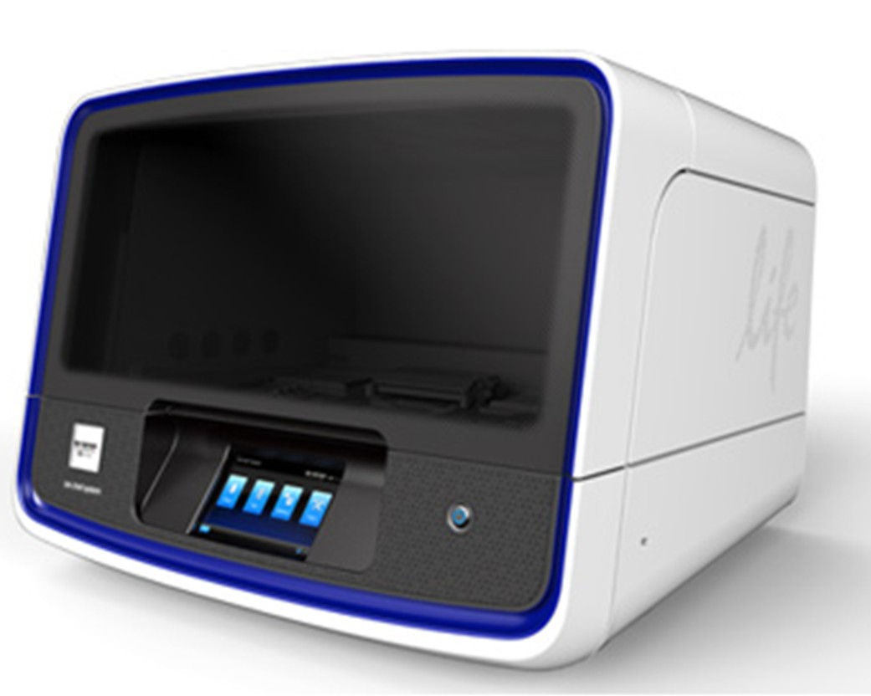
Two options for Template Prep Workflow
Library Preparation
Template Preparation*
Sequencing*
Data Analysis
OneTouch2TM ES
Template Prep Enrichment
Ion Chef TM
Template Prep , Enrichment & Loading

Slide 19
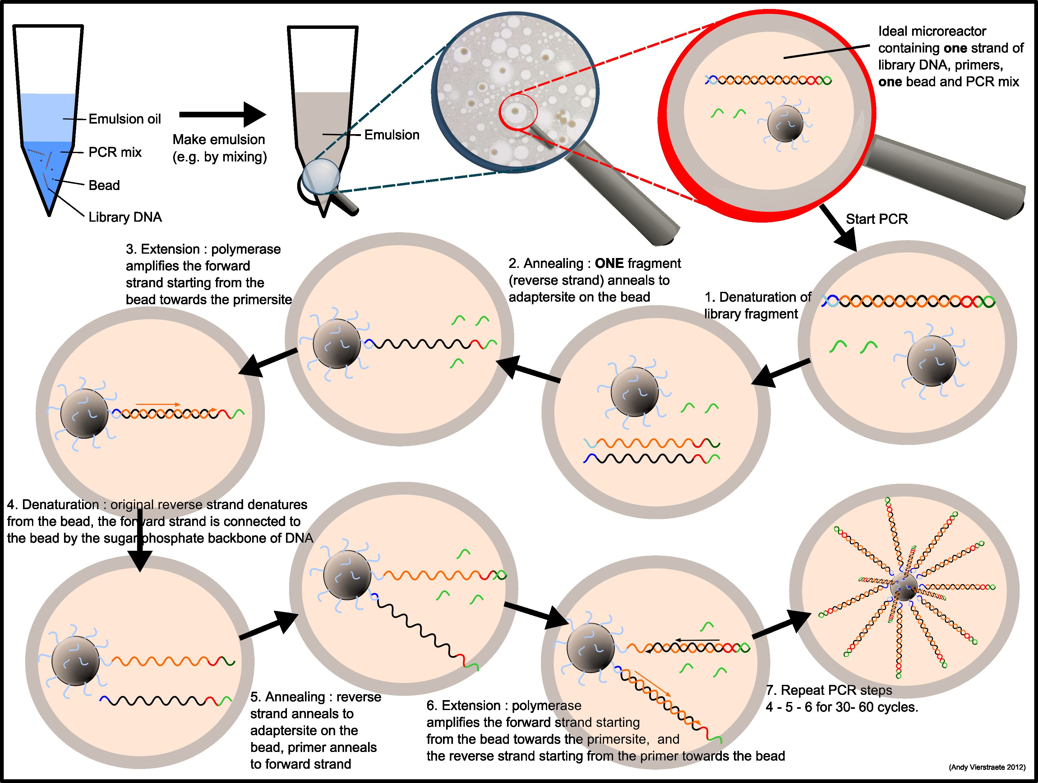
Clonal Amplification
Notes:
Introduce the idea of an emulsion.

Slide 20
Ideal Clonal Amplification

Slide 21
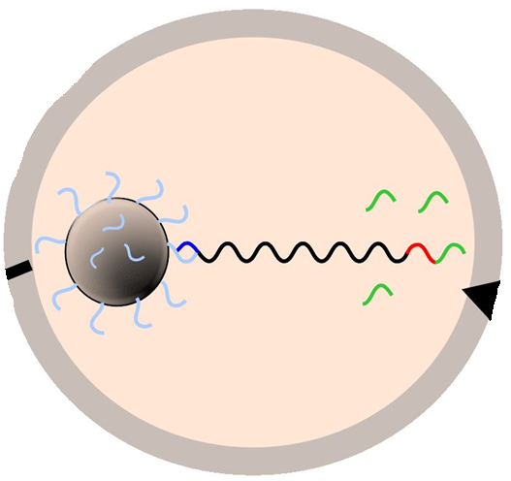





Non-Ideal Amplification
Amplification
“Non-productive”
“mixed” reads
duplicate reads

Slide 22
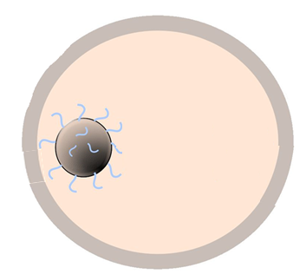
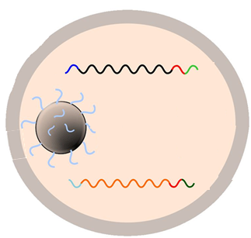
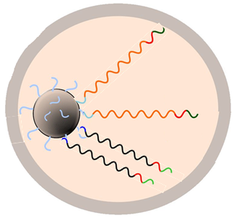
Input Optimization
Optimizing the library input concentration
Low DNA
Optimal DNA
High DNA
Increasing [DNA]
Amplification
No read
“Mixed” read
Too little library input can result in
insufficient positive,
or “live”, spheres for sequencing
Too much library input to
template prep can result in
too many “mixed” reads

Slide 23
Input Optimization
Optimal Range
% Mixed Reads
System Throughput
DNA Concentration
Optimal DNA input will maximize system throughput

Slide 24


Ion Sphere™ Particle Enrichment
Post
Amplification
Add Magnetic
Streptavidin Bead
Immobilize to
Magnet and Wash
Remove 2nd strand
with NaOH
Enriched
ISP
SA
SA
SA
SA
SA
“no template”
“no biotin” “no capture” “no yield”
Notes:
Addition of MyOne™ beads to sample to bind to biotinylated templated ISPS.
Washing
Magnetic purification
Melting Off
Recovery of template positive ISPs.

Slide 25
Ion Sphere™ Particle Enrichment (mixed reads)
Post
Amplification
Add Magnetic
Streptavidin Bead
Immobilize to
Magnet and Wash
Melting off 2nd strand
with NaOH
SA
SA
SA
*This mixed read species can be minimized through proper dilution.
Proper DNA to Ion Sphere™ Particle ratio is critical!
Notes:
Note that enrichment does not remove ‘mixed’ or ‘polyclonal’ ISPs. Those must be minimized via dilution in the template prep.

Slide 26
Ion Torrent™ Workflow
Library
Preparation
Template Preparation*
Sequencing*
Data Analysis
Notes:
Set expectations of the class:
There are several parts of the Ion workflow. The important phases are broken u here. The parts in blue we will go over in the lab together. This course does not cover the Library Prep portion of the workflow but we do offer several courses which cover this portion of the workflow.

Slide 27
Ion Workflow Overview
A
DNA
B
Compatible Library Prep
C
10
Template Prep
10
Prepare
Library
Clonal
Amplification
Isolate Positive
Ion Sphere™
Particles
Load Chip
and Sequence
D
Data Analysis
Sequencing
E
Compatible Data
Notes:
Ion Torrent Systems, Inc.
27

Slide 28
Sequencing: Flows
A “flow” is the event of exposing the chip to one particular dNTP (T, A, C, or G), followed by a washing step
The flow order repeats with pattern:
‘TACGTACGTCTGAGCATCGATCGATGTACAGC’
T
A
C
G
T
A
C
G
T
C
T
G
A
G
C
A
T
C
G
A
… etc.
T
Flows 1-4
Flows 5-8
…9-12
A
5’-Sequencing Primer-3’
C
...---Ion Sphere™
Particle
3’-CCATCTCATCCCTGCGTGTCTCCGAC A G T C A A G C G T C C C A T G
G
Adaptator A
Key Seq
Sequence of Interest
P1 seq
Flows 1-4
Notes:
HOW DO WE DEAL WITH SAMBA? NEED TO THINK ABOUT THIS AS WE DON’T WANT TO DRAW TONS OF ATTENTION TO FLOW ORDER BUT THIS CONCEPT IS IMPORTANT.
Focus on the following: The key flows are important for recognizing the type of ISP (library or control) and for identifying what a signal of “1” looks like. After that, the flow order really doesn’t matter – just show them we are sequencing by synthesis, in towards the ISP, sometimes incorporating 0 bases, 1 base, or several bases per flow.
Ion Torrent Systems, Inc.
2/2/2017
28

Slide 29
Sequencing: Flows
A “flow” is the event of exposing the chip to one particular dNTP (T, A, C, or G), followed by a washing step
The flow order repeats with pattern:
‘TACGTACGTCTGAGCATCGATCGATGTACAGC’
T
A
C
G
T
A
C
G
T
C
T
G
A
G
C
A
T
C
G
A
… etc.
T
Flows 1-4
Flows 5-8
…9-12
A
5’-Sequencing Primer-3’
T
C
C
3’-CCATCTCATCCCTGCGTGTCTCCGAC A G T C A A G C G T C C C A T G
...---Ion Sphere™
Particle
G
Adaptator A
Key Seq
Sequence of Interest
P1 seq
Flows 5-8
Notes:
Ion Torrent Systems, Inc.
2/2/2017
29

Slide 30
Sequencing: Flows
A “flow” is the event of exposing the chip to one particular dNTP (T, A, C, or G), followed by a washing step
The flow order repeats with pattern:
‘TACGTACGTCTGAGCATCGATCGATGTACAGC’
T
A
C
G
T
A
C
G
T
C
T
G
A
G
C
A
T
C
G
A
… etc.
T
Flows 1-4
Flows 5-8
…9-12
T
C
5’-Sequencing Primer-3’
T
C
A
G
T
3’-CCATCTCATCCCTGCGTGTCTCCGAC A G T C A A G C G T C C C A T G
...---Ion Sphere™
Particle
G
Adaptator A
Key Seq
Sequence of Interest
P1 seq
Flows 9+
Notes:
Ion Torrent Systems, Inc.
2/2/2017
30

Slide 31
Sequencing: Flows
A “flow” is the event of exposing the chip to one particular dNTP (T, A, C, or G), followed by a washing step
The flow order repeats with pattern:
‘TACGTACGTCTGAGCATCGATCGATGTACAGC’
T
A
C
G
T
A
C
G
T
C
T
G
A
G
C
A
T
C
G
A
… etc.
T
Flows 1-4
Flow 5-8
…9-12
T
C
5’-Sequencing Primer-3’
T
C
A
G
T
T
C
G
C
A
G
G
G
T
A
C
G
3’-CCATCTCATCCCTGCGTGTCTCCGAC A G T C A A G C G T C C C A T G
...---Ion Sphere™
Particle
A
Adaptor A
Key Seq
Sequence of Interest
P1 seq
And so on…
Notes:
Ion Torrent Systems, Inc.
2/2/2017
31

Slide 32
Ion Torrent™ Workflow
Library
Preparation
Template Preparation*
Sequencing*
Data Analysis
Notes:
Set expectations of the class:
There are several parts of the Ion workflow. The important phases are broken u here. The parts in blue we will go over in the lab together. This course does not cover the Library Prep portion of the workflow but we do offer several courses which cover this portion of the workflow.

Slide 33
Ion Workflow Overview
A
DNA
B
Compatible Library Prep
C
10
Template Prep
10
Prepare
Library
Clonal
Amplification
Isolate Positive
Ion Sphere™
Particles
Load Chip
and Sequence
D
Data Analysis
Sequencing
E
Compatible Data
Notes:
Ion Torrent Systems, Inc.
33

Slide 34
Ion S5 & S5xlTM System - Torrent Server Inside
Torrent Suite™ Software
Preloaded with Torrent Suite™ Software
Converts raw signal to base calls
Performs preliminary alignment to a reference genome allowing run quality assessment
Torrent Browser plugins
Hosts web portal for data review and distribution to collaborators
Notes:
Torrent Server is the computer hardware running the Torrent Suite software
pre-configured with software
only way to access Torrent Suite software
Contains GPU
Based on Dell T710 Server
USD $16,500
Euro €17,500
GBP £15,500
Part Number 700-2010-01
34

Slide 35
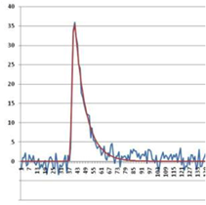
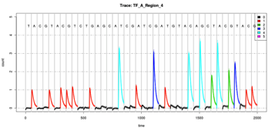
Torrent SuiteTM Data Analysis Flow
Incorporation for
1 Flow (DAT)
Incorporation over
many flows (DAT)
Raw signals per flow (WELLS)
0.1 1.2 0.3 2.1 0.1 0.2 2.1 3.1 0.0
0.2 2.1 3.1 0.0 0.1 1.2 0.3 2.1 0.0
0.0 0.0 3.2 1.4 0.1 1.3 1.0 0.2 0.1
Signal
Processing
Base Calling
FASTQ
Unmapped BAM file
with base calls
& raw normalized signals
(optional)
VCF
BAM
For details on file formats & data analysis,
see the full documentation on the Ion Community.

Slide 36
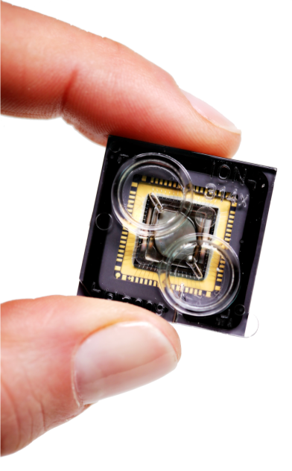

Ion Torrent™ : Semiconductor Sequencing for Life™
Support
Robert David
6178723352
Robert.David@thermofisher
ionsupport@lifetech.com
Call 800-955-6288 in USA
Bioinformatics support
ngs-amsupport@lifetech.com
Jingwei.Ni@thermofisher.com
Online info for Ion Torrent Systems Thermofisher Ion Community
The Chip is the Machine™
Notes:
PLEASE CHANGE TECH SUPPORT NUMBER TO MATCH YOUR REGION’S CONTACT INFORMATION – THIS IS US-ONLY

Slide 37

For Research Use Only. Not for use in diagnostic procedures.
Ion Torrent™ is a Thermo Fisher Scientific brand. © 2014 Thermo Fisher Scientific, Inc. All rights reserved. TaqMan is a registered trademark of Roche Molecular Systems, Inc., used under permission and license. All other trademarks are the property of Thermo Fisher Scientific and its subsidiaries.

